Slide 1
Cortex M3 Bit-Band Region

Slide 2


Slide 3


Slide 4
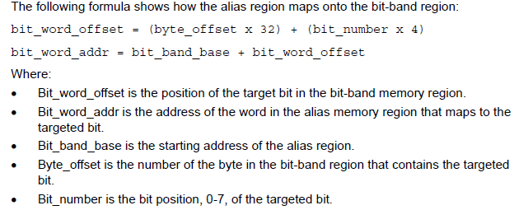

Slide 5
